Slide 1
Creating the Ideal Patient Care Experience Michigan Society for Healthcare Planning and Marketing
Spring Conference
May 6, 2016

Slide 2
Consider the Health Care Experience
“Health care experiences have an indelible quality.”
“When our normal physical and mental functioning is uncertain, or when we are brought face to face with the fragility of life, all of our senses are heightened.”
“As a result, health care experiences, for all the people who play a part in whatever the drama is, whether it be large or small…are situations that people remember with great intensity.”
Crocker and Johnson, Privileged Presence, Bull Publishing Company, 2006.2006.
Notes:
2

Slide 3
Defining the Ideal Patient
Care Experience
Where to begin….
The Institute of Medicine’s “Crossing the Quality Chasm” has provided the vision.
Notes:
Six Aims of IOM Crossing the Quality Chasm Report 1
1 Crossing the Quality Chasm: A New Health System for the 21st Century. Institute of Medicine, National Academy of Sciences. 2000.
Safe
Effective
Patient-Centered
Timely
Efficient
Equitable
Ten Rules of IOM Crossing the Quality Chasm Report
1) Care based on continuous healing relationships
2) Customization based on patient needs and values.
3) The patient as the source of control.
4) Shared knowledge and the free flow of information.
5) Evidence-based decision making.
6) Safety as a system property.
7) The need for transparency.
8) Antic ipation of needs.
9) Continuous decrease in waste.
10) Cooperation among clinicians.

Slide 4
“Crossing the Quality Chasm” Six Aims
Health care must be:
Safe
Effective
Patient-centered
Timely
Efficient
Equitable
Source: Crossing the Quality Chasm: A New Health System for the 21st Century, Institute of Medicine, National Academy of Sciences, 2000, pp 39-40.

Slide 5
“Crossing the Quality Chasm”
Ten Rules For Care
Care based on continuous healing relationships
Customization based on patient needs and values
The patient as the source of control
Shared knowledge and the free flow of information
Evidence-based decision making
Safety as a system property
The need for transparency
Anticipation of needs
Continuous decrease in waste
Cooperation among clinicians
Source: Crossing the Quality Chasm: A New Health System for the 21st Century, Institute of Medicine, National Academy of Sciences, 2000, pp 61-62.

Slide 6
“Nothing About Me Without Me”
Patient and Family Centered Care (PFCC)
is a Philosophy, a Process and a Practice
PFCC is a national movement within healthcare that promotes a true partnership with patients and families…
…bringing their perspectives into the planning, delivery, practice, and evaluation of health care, to ultimately transform the care experience and improve quality and safety.
Notes:
Patient- and family-centered care is an approach to the planning, delivery, and evaluation of health care that is grounded in mutually beneficial partnerships among health care providers, patients, and families. It redefines the relationships in health care.
Patient- and family-centered practitioners recognize the vital role that families play in ensuring the health and well-being of infants, children, adolescents, and family members of all ages. They acknowledge that emotional, social, and developmental support are integral components of health care. They promote the health and well-being of individuals and families and restore dignity and control to them.
Patient- and family-centered care is an approach to health care that shapes policies, programs, facility design, and staff day-to-day interactions. It leads to better health outcomes and wiser allocation of resources, and greater patient and family satisfaction.
6

Slide 7
The Wisdom of Stories
The more patients are viewed as people with stories…
the more the relationships between caregivers and patients are humanized…
the more patients are viewed as people rather than diseases…
and the more patients are protected from error. (Stone 2006)

Slide 8
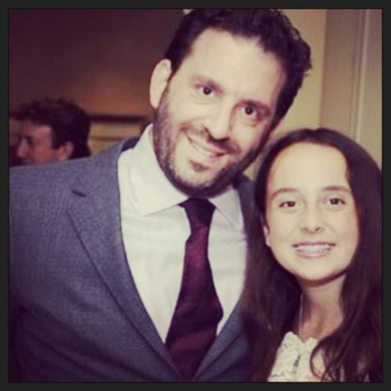
Erik’s Story
Husband
and
Father
Son and Brother

Slide 9
PFCC Key Principles
Dignity and Respect
Information Sharing
Participation
Collaboration
From patient and family focused care where we do things “to” and “for” patients to…
Patient and family centered care…where we work “with” each other to achieve the best outcomes possible
Notes:
Dignity and Respect. We listen to and honor patient and family perspectives and choices, incorporating their knowledge, values, beliefs and cultural backgrounds into the planning and delivery of care.
Information Sharing. We communicate and share complete, timely, accurate, and unbiased information in ways that are affirming and useful for patients and families to participate in care and decision-making.
Participation. Patients and families are encouraged and supported in participating in care and decision-making at the level they choose.
Collaboration. Health care leaders collaborate with patients and families in policy and program development, implementation, and evaluation; in health care facility design; and in professional education, and the delivery of care.

Slide 10
Patient Family Centered Care Key Principles
Dignity and Respect. Health care practitioners listen to and honor patient and family perspectives and choices. Patient and family knowledge, values, beliefs and cultural backgrounds are incorporated into the planning and delivery of care.
Information Sharing. Health care practitioners communicate and share complete and unbiased information with patients and families in ways that are affirming and useful. Patients and families receive timely, complete, and accurate information in order to effectively participate in care and decision-making.

Slide 11
Patient Family Centered Care Key Principles
Participation. Patients and families are encouraged and supported in participating in care and decision-making at the level they choose.
Collaboration. Patients and families are also included on an institution-wide basis. Health care leaders collaborate with patients and families in policy and program development, implementation, and evaluation; in health care facility design; and in professional education, as well as in the delivery of care.

Slide 12
PFCC in Action
Family presence …during patient rounds, codes, end of life, to stay with patient; family initiated rapid response team
No visiting hours…families are not visitors; they are part of the care team
Transparency in information sharing, including medical records, medication distribution, results, care plan, etc.
Including patients and family members in active decision making regarding their care and the services delivered, especially transitional care

Slide 13
The Patient and Family Voice
Create patient family advisory committees where patients have a voice at the table
Include patients and families on safety and quality committees to improve outcomes, decrease hospital acquired illnesses, and improve safety
Patients and families review educational material and provide resources for future patients and families
Patients and families share their perspectives about their experience, so that we may better understand and improve the experience

Slide 14
PFCC is a Journey
PFCC began in Children’s Hospitals.
Nursing Model of Care and Care Management Model designed with patients as the “drivers of their care.”
Visitation Policy recognizes families are not visitors.
Hosted the Institute for Patient and Family Centered Care conference in 2012, funded by donors, educating 250 employees and 31 patients and family members with 57 action plans generated.
Created an annual educational PFCC conference since 2009.
PFCC was recognized as a formal department.

Slide 15
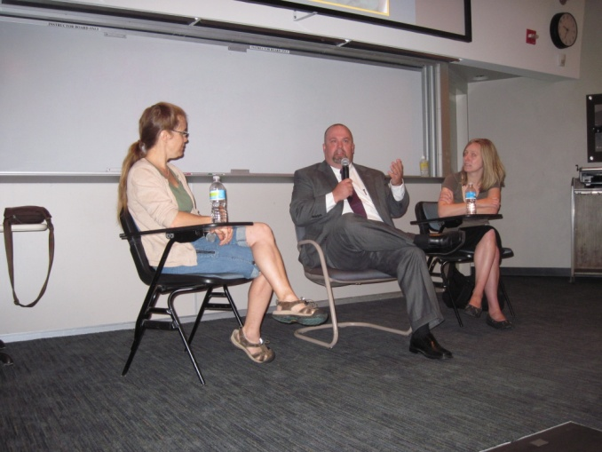
Patient and Family Member Roles
Patients and Family Members serve in many roles…
Patient and Family Advisory Councils (PFACs)
E-Advisors
Ad hoc Patient and Family Advisors
Established formal volunteer orientation process
Peer Mentors
Theater, simulations, and panels
Notes:
Other opportunities where patients and families participate:
Hospital Committee Memberships
Speakers Bureau / Panels
Peer Mentors (7)
PFCC theater - simulation
Task Forces
Collaborative Conversations
E-Advisors (40+ annually)
Nursing Model of Care designed with patients as the source of control.
Bedside rounds with the entire care team and patients and families.
Nursing shift report at the bedside.
Family presence …during rounds, codes, end of life, to stay with patient; and given permission to initiate the rapid response team.
No “visiting hours” for families; families are part of the care team, no longer seen as visitors.
Transparency in information sharing, including medical records, medication distribution, results, care plan, etc.
Patients and family members are involved in care planning and decisions and provide critical feedback to the care process.

Slide 16
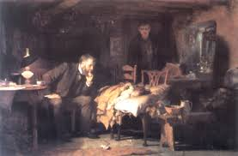
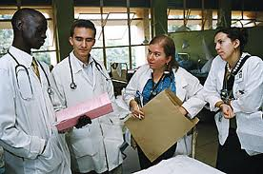
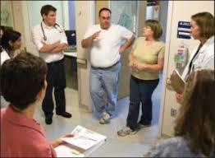
PFCC at the Episode of Care
FROM…family as bystanders…
and teaching rounds outside the room
To full engagement with patients, families and the entire care team at the bedside.
Notes:
Nursing Model of Care designed with patients as the source of control.
Bedside rounds with the entire care team and patients and families.
Nursing shift report at the bedside.
Family presence …during rounds, codes, end of life, to stay with patient; and given permission to initiate the rapid response team.
No “visiting hours” for families; families are part of the care team, no longer seen as visitors.
Transparency in information sharing, including medical records, medication distribution, results, care plan, etc.
Patients and family members are involved in care planning and decisions and provide critical feedback to the care process.

Slide 17
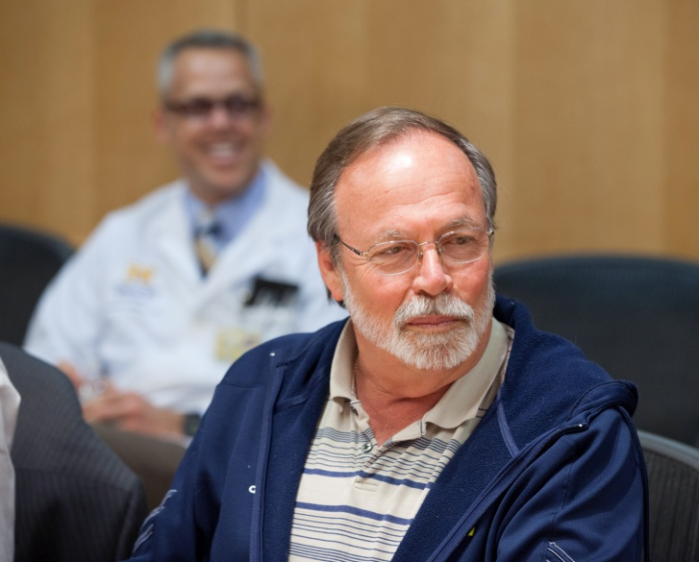
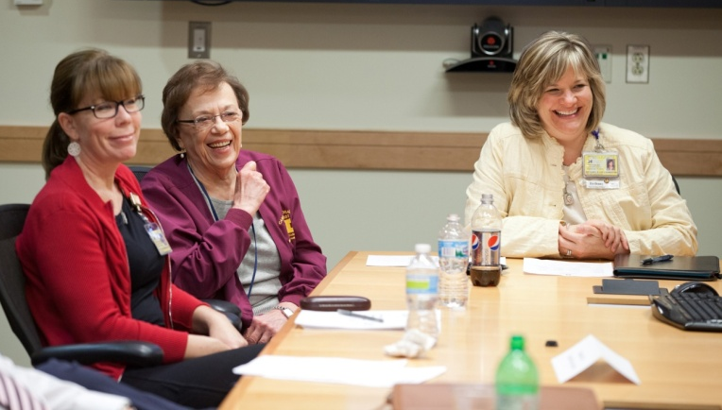
PFCC at the Unit Level
Patients and family members…
Serve on advisory committees
Safety and quality committees
Review educational material
Provide information for future patients
Share their experiences to staff
Notes:
Patient and family advisory committees give patients a voice at the table.
Including patients and families on safety and quality committees improve outcomes, decrease hospital acquired illnesses, and improve safety.
Patients and families review educational material and provide resources for future patients and families.
Patients and families share their experiences to staff, so that we may better understand and improve the experience.

Slide 18
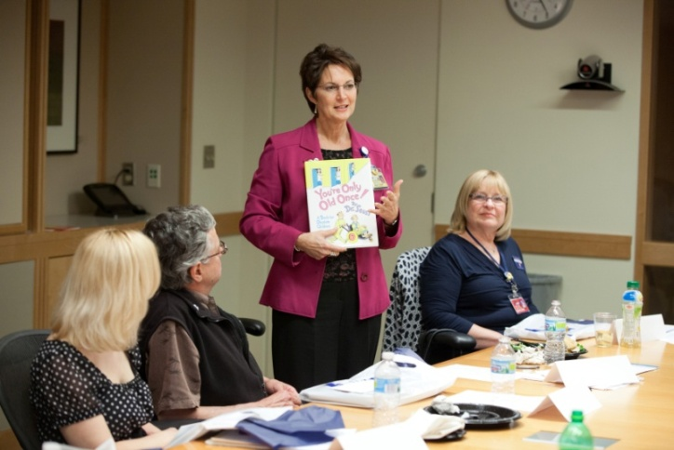
PFCC in the Board Room
Patients and Families partner in:
Governance committees
Shaping policy and programs
Facility design and planning
Quality and safety committees
Process improvement initiatives
Review of educational materials
Medical student training
Notes:
Patients and Families are included in:
Institutional boards and participate in decision-making and policy development. NAB and CVC Exec Group.
Quality and safety committees
Process improvement initiatives
Facility design and program planning
Review of educational materials
Medical and health science student training (e.g. Family Centered Experience)

Slide 19
PFCC at the National Level
UMHS sponsored the Institute for Patient- and Family-Centered Care (IPFCC) conference in Michigan in 2006 and 2012.
Three UMHS staff are current faculty of IPFCC.
Patient-centered Outcomes Research Institute (www.PCORI.org) includes our patients & families on advisory panels.
UMHS patients, families and staff regularly present nationally at professional organizations.
Released a book of patient stories and PFCC by Health Administration Press in 2013.

Slide 20
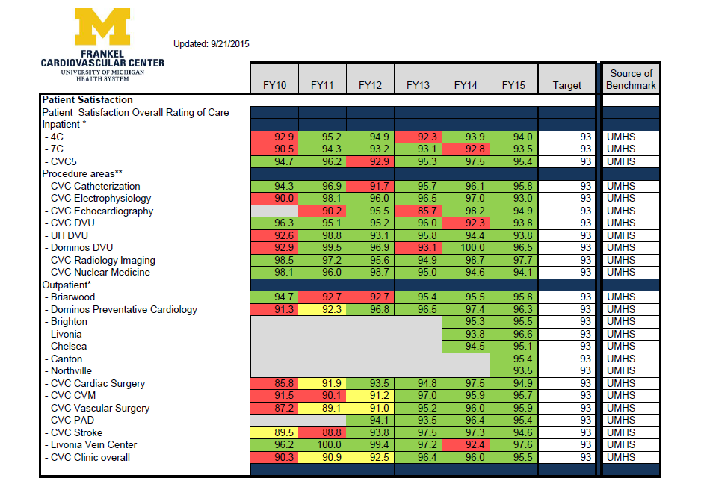
FCVC Patient Satisfaction Results

Slide 21
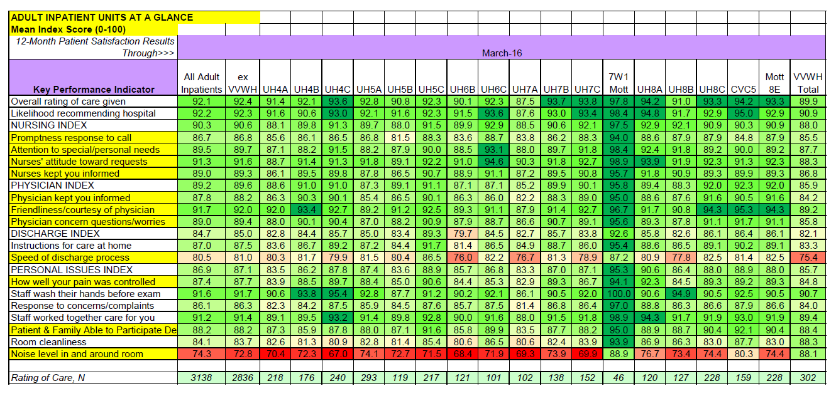
HCAHPS Results

Slide 22
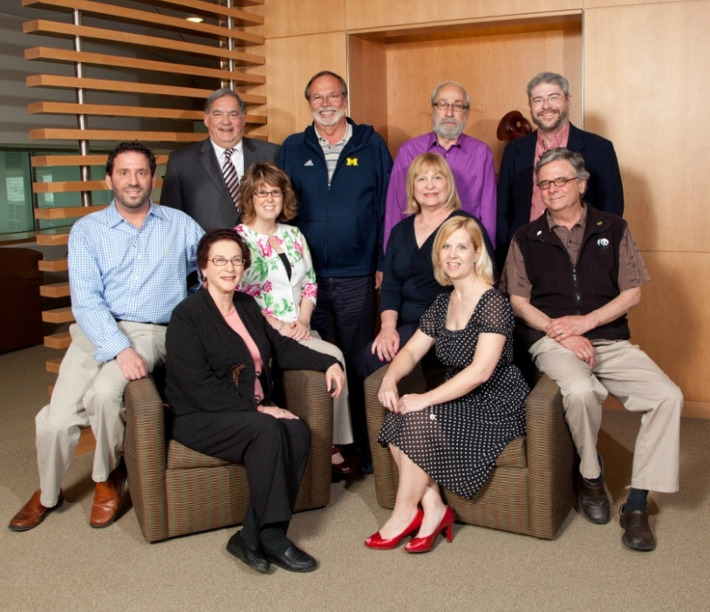
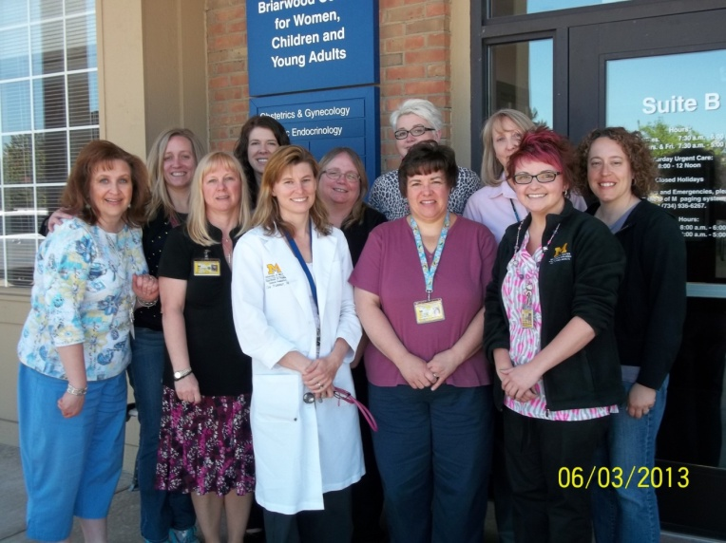
Questions?

